Slide 1
Using Chemical Lifecycle Management to Minimize the Environmental Footprint of Operations
Presented at the DOE/EFCOG Chemical Management Workshop
March 17, 2010
Jennifer Carter, LEED AP, ABCP
JCarter Consulting, LLC
jenni@jcarterconsulting.net
www.hss.energy.gov

Slide 2
”Reduced Environmental Footprint”
…One of many buzz-phrases for a family of related concepts:
Environmentally Conscious Manufacturing, Green Operations, Supply Chain Greening, Sustainable Manufacturing, Design for Environment, Environmental Stewardship, Life Cycle-Based Manufacturing, Green Chemistry, Green Products…
For today’s discussion, “Environmental Footprint” is not “Ecological Footprint”

Slide 3
Traditional Environmental Footprint of Operations
Traditional Environmental Components:
Regulated emissions to air – specific pollutants above regulated thresholds
Regulated emissions to water – specific pollutants above regulated thresholds
Hazardous, special, and non-hazardous waste generation
Traditional Operations in the Footprint:
Manufacturing processes
Manufacturing utilities

Slide 4
Evolving Expectations
Add These Environmental Components:
Greenhouse gas emissions
Energy use
Embedded/embodied energy
Water use
Non-renewable resource depletion – recycled content, bio-based content, etc.
Non-regulated chemical emissions to air and water
“Chemicals of interest”

Slide 5
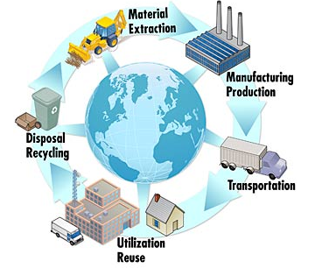
Evolving Expectations
Add these Operations to the Footprint
Site administrative and support activities
Supply Chain contribution – cradle to gate, including impacts from utility supplier, contract manufacturing, etc.
Other offsite activities in your control
www.nist.gov/mel/msid/dpg/lifecycle.cfm

Slide 6
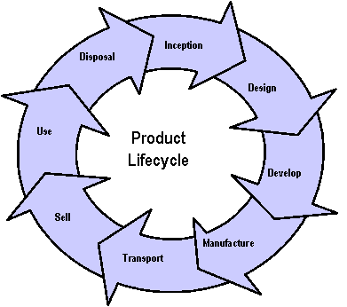
Evolving Expectations
Added Operations, cont’d
Product or service contribution to all “environmental footprint” components throughout lifecycle
Packaging, inserts, documentation
Transportation/distribution from point of manufacture to the customer
Use by the customer
Post-use disposition - take-back, disassembly, refurbishment, re-use, recycle, disposal
www.osha.gov/ dsg/hazcom/ghs.html

Slide 7
Environmental Footprint Reduction Requirement: EO 13514
Executive Order 13514 (10/5/09) Federal Leadership in Environmental, Energy, and Economic Performance
Ensure 95% of all new contracts, including non-exempt contract modifications, require products and services that are energy-efficient, water-efficient, bio-based, environmentally preferable, non-ozone depleting, contain recycled-content, non-toxic or less-toxic alternatives
Expands on (does NOT rescind) energy and environmental performance requirements of EO 13423

Slide 8
Chemical Lifecycle Management Typical “Footprint Reduction” Gaps

Slide 9
Moving Beyond Traditional
Requires much more significant supply chain involvement (further up- and down-chain)
Requires additional environmental data for the materials you consider for purchase
Requires shift of assessment focus from ‘acceptance’ to ‘improvement’

Slide 10
Challenges
There will be competing factors (safety vs. environmental toxicity vs. GHG… not to mention efficacy and cost).
MSDS and Chemical Inventory Software not environmentally robust
Environmental footprint attributes often not known by suppliers
Your data includes only what you already buy
Difficult to determine when you’ve reached “Green” or “Sustainable” or “Environmentally Preferable”

Slide 11
What is Industry Doing?
According to an October ‘09 greenbiz.com survey, inbound material supplies are screened for ‘green’ attributes by:
73% of basic materials firms (chemicals, metals, oil and gas, and specialty chemicals)
58% of office products distributors
53% of consumer goods manufacturers
52% of industrial goods manufacturers
48% of technology companies

Slide 12
What is Industry Doing?
59% of surveyed companies said they have a Green procurement policy and/or include green criteria in RFPs
44% of large companies assess supplier environmental performance, and 36% audit their suppliers.
ISO 14001 identified as a leading factor for companies >$1B; published CSR or sustainability reports for smaller companies

Slide 13
Who are the Industry Leaders?
Consumer Goods Manufacturers: Nike, GM, GE, HP, Apple, SC Johnson, 3M, Pfizer, Kodak, Intel
The ultimate distribution channel: Wal-Mart
Driving forces = Market forces
Preventing market access disruption caused by restricted substance presence in product
Support claims of “Green” or “Environmentally Preferable” and attainment of applicable labels/ certifications

Slide 14
Industry Leaders, cont’d.
Nike, SC Johnson, and HP chemical management programs are described in Green Chemistry in Commerce Council (GC3) Case Study “Gathering Chemical Information & Advancing Safer Chemistry in Complex Supply Chains” Lowell Center for Sustainable Production, UMass Lowell
Common themes to the chemical management approaches used by these three companies:
Customized data management systems (not just lists) with product-specific capability;
Years-long development cycles;

Slide 15
Nike
Nike’s ‘Considered Index’ tool predicts product environmental footprint in design phase
Solvent use, waste, materials and innovation for footwear; Waste, materials, garment treatments and innovation for apparel
Restricted Substance List (RSL) tool has 9 distinct lists, including nanotechnology, packaging and toy-specific; materials restricted by legislation plus additional “Chemicals of Concern” Nike declares undesirable
Testing and data management system for supplier compliance.
Chemical evaluation system for possible addition to RSL and/or need for environmentally preferred substitutes

Slide 16
Nike Considered Chemistry Material Analysis Tool

Slide 17
SC Johnson
Greenlist™
Raw materials rated on environmental and human health impact. In-house designed rating criteria for 19 material categories.
“A process, NOT a chemical list”
Scores provided to company chemists alongside performance and cost information. Incentives encourage safer materials selection and discourage less safe materials
Provides metrics for tracking corporate-wide progress toward greening the portfolio of products.
www.whatsinsidescjohnson.com provides chemical ingredient information to consumers.

Slide 18
SC Johnson
Greenlist™
In-house team had looked at existing product and raw material evaluation tools and found most had major deficiencies
Complexity to use
Cost to purchase / license
Needed data was not readily available
Customized application developed by FiveWinds, available for licensing

Slide 19
Walmart
Establishing the Walmart Sustainability Index in 3 phases:
Top-tier suppliers in the U.S. were required to complete Sustainability Assessment by October 1, 2009; more suppliers to follow
Provided initial funding for a Sustainability Consortium to develop a Lifecycle Analysis database; inaugurated 3/17/09
(http://www.sustainabilityconsortium.org/)
Will develop a simple customer tool for comparison

Slide 20
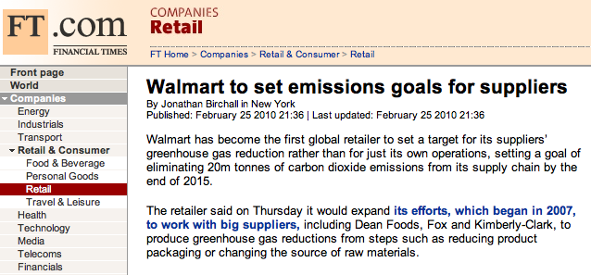

Slide 21
Apple
Apple requires suppliers to commit to a Supplier Code of Conduct, then performs onsite audits, approves corrective action plans, and verifies implementation. Environmentally, includes requirements for:
Hazardous Substance Management and Restrictions
Solid Waste Management
Wastewater and Stormwater Management
Air Emissions Management
Permits and Reporting
Pollution Prevention and Source Reduction

Slide 22
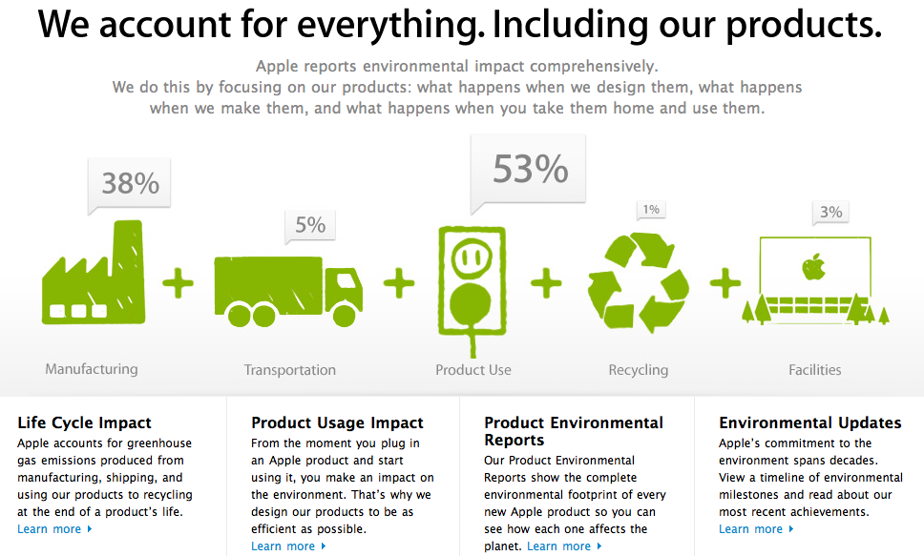
http://www.apple.com/environment/

Slide 23
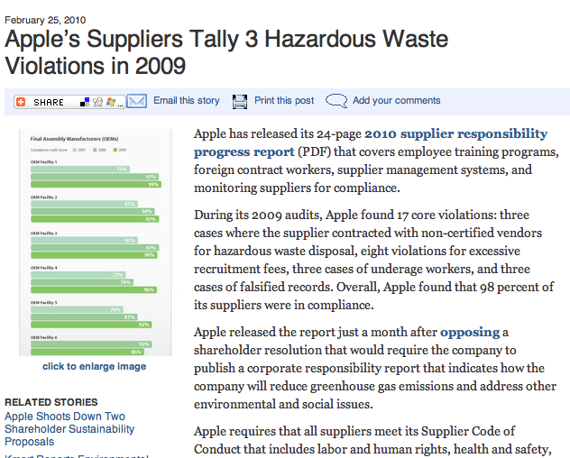

Slide 24
Where Do You Start?
Determine the most appropriate operational and product lifecycle boundaries to include in the environmental footprint: What are your driving forces? Walk before you run!
Based on the boundaries, determine the most appropriate environmental attributes for your operations (and products, if applicable)
Assess your existing chemical lifecycle management approach (databases, approval processes, data management strategies) for gaps
Seek gap fillers and fill the gaps (much easier said than done!)

Slide 25
Tools to Fill the Gaps
Tool types range from (limited) lists of ‘green’ or ‘environmentally preferable’ products and Regulated Substance Lists (RSLs) to data management tools to very complex Lifecycle Analysis (LCA) tools
There is likely a “sweet spot” (ability to meet your needs vs complexity or laboriousness of use)

Slide 26
Free Tools and Data
EPA’s Environmentally Preferable Purchasing Database – focused on building products, cleaners, some lubricants and oils, but very few other “chemicals” http://yosemite1.epa.gov/oppt/eppstand2.nsf/Pages/DisplayAisle.html?Open&Hardware%20Store&Chemicals&Type=4
MIT Green Alternatives Wizard – focus on common laboratory solvents and associated process http://web.mit.edu/environment/academic/wizard/greenChemWiz5.html

Slide 27
Free Tools and Data
Green Products Compilation – products for which EPA, DOE, and USDA provide environmental or energy attribute recommendations http://www.fedcenter.gov/Documents/index.cfm?id=11767&pge_prg_id=20257
American Chemical Society Green Chemistry Institute® Exchange http://www.greenchemex.org/
EPA DfE “Safer Products” - includes basic environmental toxicity and fate life cycle info for cleaning products, coatings, some others http://www.epa.gov/dfe/index.htm

Slide 28
Free Tools and Data
GSA Carbon Footprint and Green Procurement Tool – For management of your data to track carbon footprint https://green-gsa.noblis.org/
University of Bath Inventory of Carbon and Energy database http://www.bath.ac.uk/mech-eng/sert/embodied/
National Renewable Energy Laboratory Life Cycle Inventory Database - material and energy flows for a few unit ops (e.g., chemical or fabricated metal products manufacturing) http://www.nrel.gov/lci/database/default.asp

Slide 29
Free Tools and Data
Carnegie-Mellon Economic Input-Output Life Cycle Analysis Tool - Estimates materials and energy resources required for, and environmental impacts resulting from, economic activities. Provides guidance on relative impacts of different products, materials, services, or industries through the supply chain. Contains a limited number of environmental effects. http://www.eiolca.net/index.html

Slide 30
Additional Interesting Information
NIST Manufacturing Engineering Laboratory “Sustainable and Lifecycle Information-based Manufacturing Program, attempting to develop harmonized standards for Sustainable Manufacturing http://www.mel.nist.gov/programs/slim.htm

Slide 31
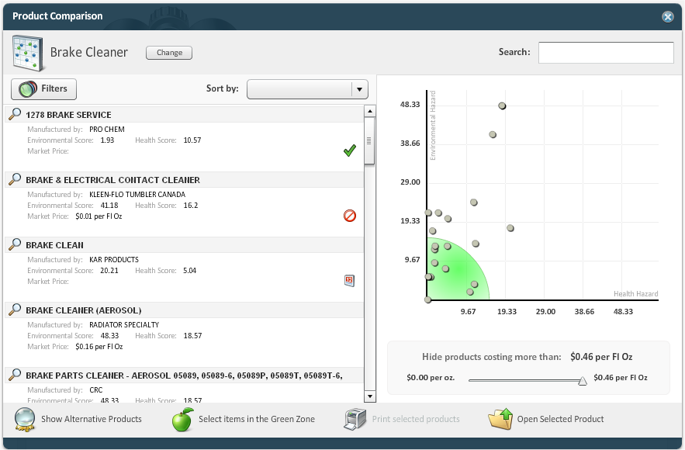
Example Commercial Tool – IHS ecoAnalysisTM

Slide 32
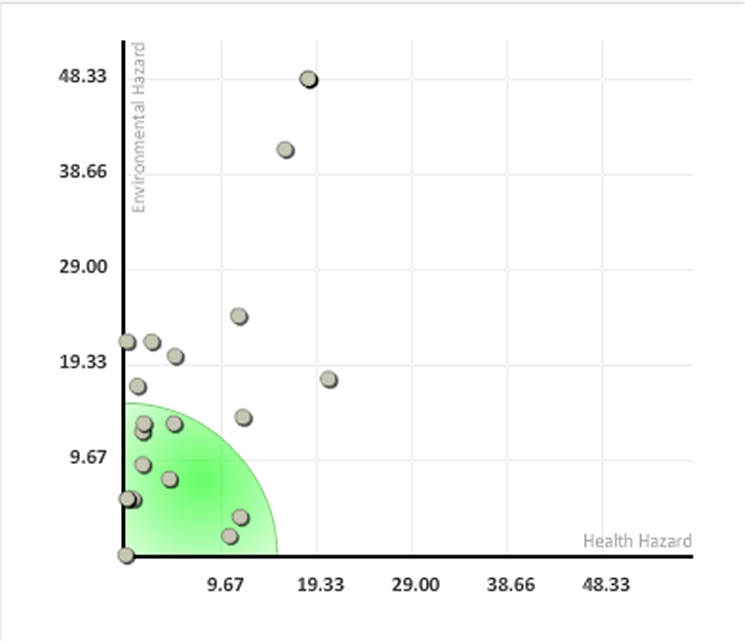
Notes:
Close up of the grid

Slide 33
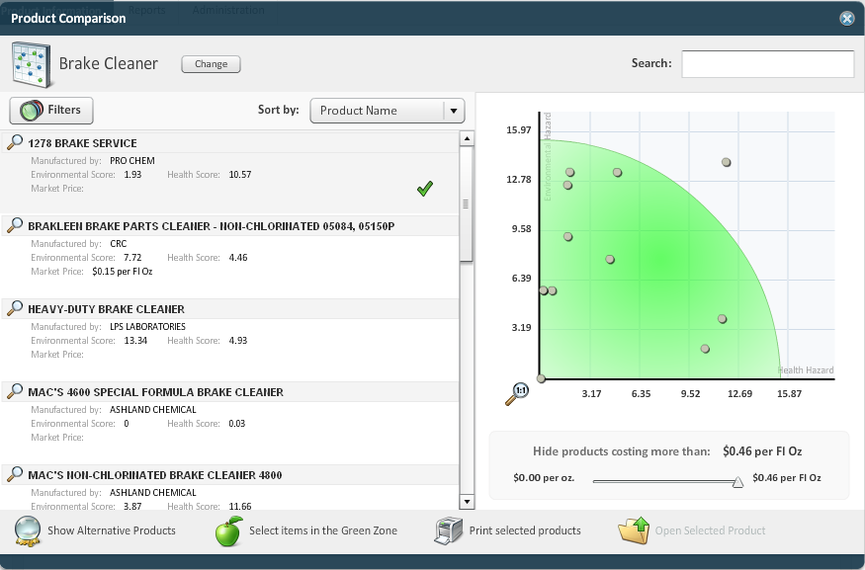
Notes:
This screen shows a subset of the orignal basket of Brake Cleaners, where the ‘nastiest’ products have been deselected due to high scores, based on risks associated with the selected endpoints and associated lists.
The remaining product grouping is more manageable and allows for further evaluation and decision making.
For a government organization, this screening process could very easily be tailored to identify all priority chemicals and in turn, create a ‘preferred products’ list, as well as a ‘non preferred’ product list that could be updated and real time, allowing for companies who reformulate to be rewarded and recognized through immediate market presence and government acknowledgement – all of this helps to
1 – reduce toxins in the environment
2 – drive improvements in products as companies look to eliminate toxins

Slide 34
The Good News
The EU Regulation on Registration, Evaluation, Authorisation and Restriction of Chemicals (REACH) will require additional environmental data to be gathered (or developed) for approximately 30,000 chemicals over the next decade. Non-confidential data will be available on REACH-IT, and will likely be incorporated into commercially-available programs.

Slide 35
If You Use a Chemical Management Supplier
Some important questions:
How robust is their environmental attribute information? Does it include most of those you believe are needed in your environmental footprint?
Will they provide to you information on alternatives beyond those chemicals that are available from them?

Slide 36
Conclusions
Moving beyond traditional chemical management for “environmental footprint” poses challenges, but is more and more expected
What are the expectations for your operations and products now? What will they be 5 years from now?
Your challenges will be reduced over time by increased awareness in the supply chain, and by evolving regulation (even those to which you may not be subject, such as REACH)

